Slide 1







R Studio Dataset
Student Health & Attendance Data
Data Analyst Camp Ousean Group
Muhammad Aziz Habiburrahim

Slide 2

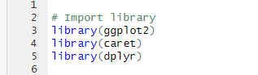
IMPORT LIBRARY
INPUT

Slide 3
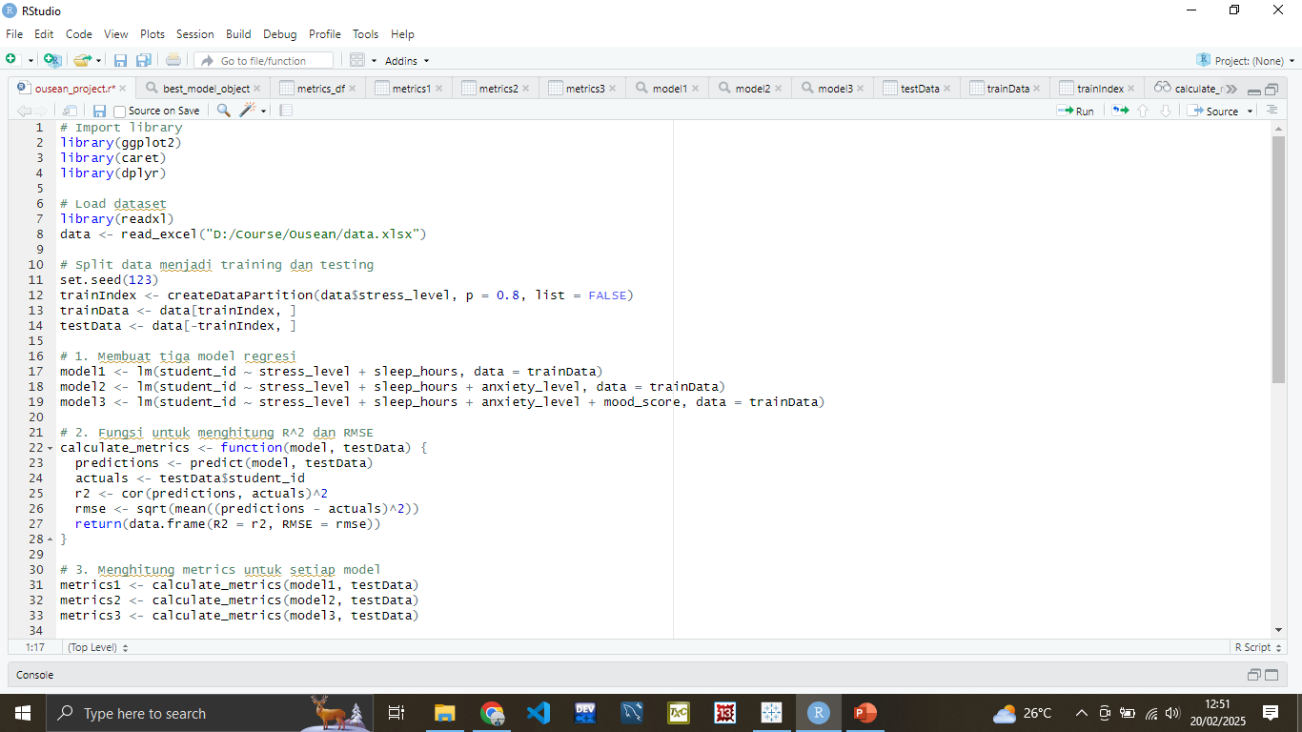
LOAD DATASET
INPUT

Slide 4
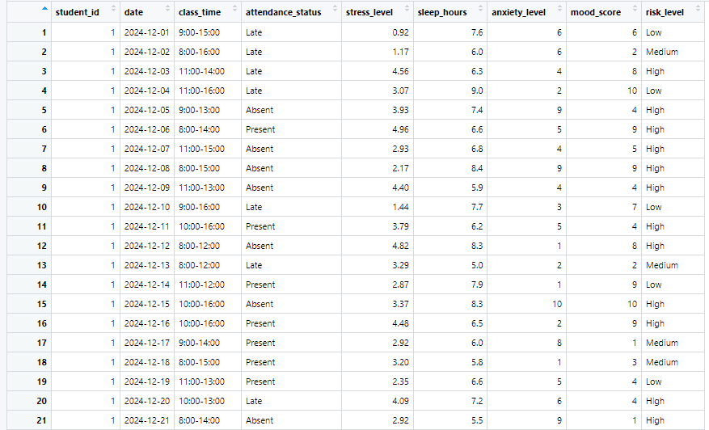
LOAD DATASET
OUTPUT

Slide 5
SPLIT DATA
INPUT

Slide 6
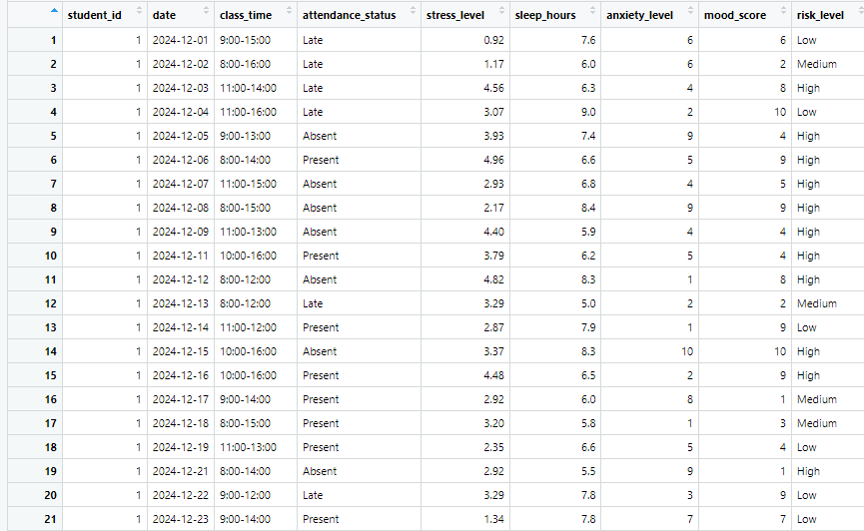
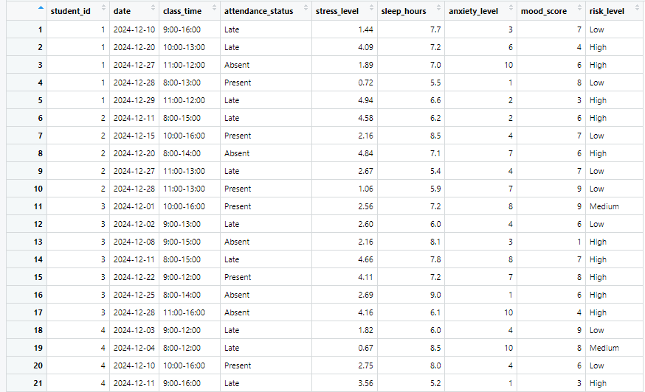
SPLIT DATA
OUTPUT

Slide 7
MODEL THREE
INPUT

Slide 8
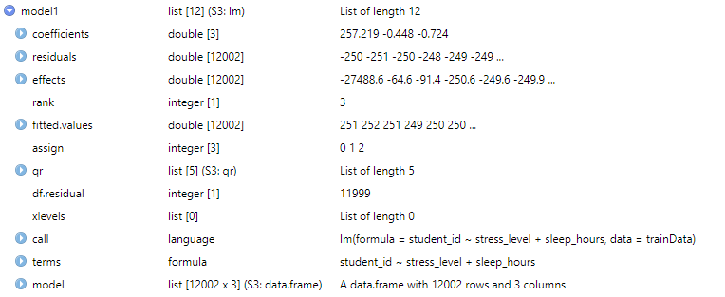
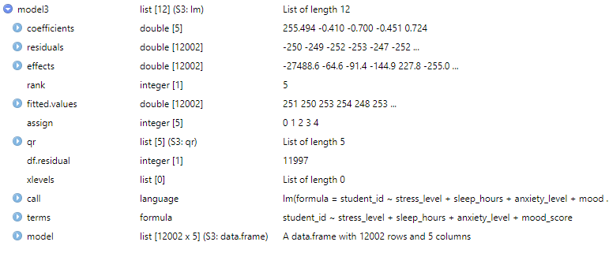
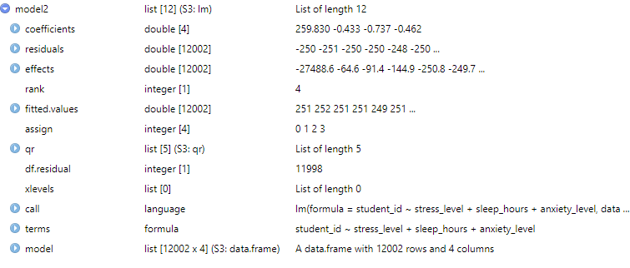
MODEL THREE
OUTPUT

Slide 9
R2 & RMSE FUNCTION
INPUT

Slide 10
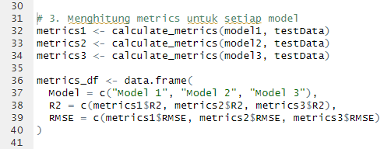
CALCULATE METRICS
INPUT

Slide 11
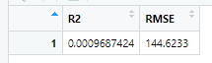

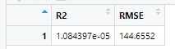

CALCULATE METRICS
OUTPUT
METRICS 1
METRICS 2
METRICS 3

Slide 12
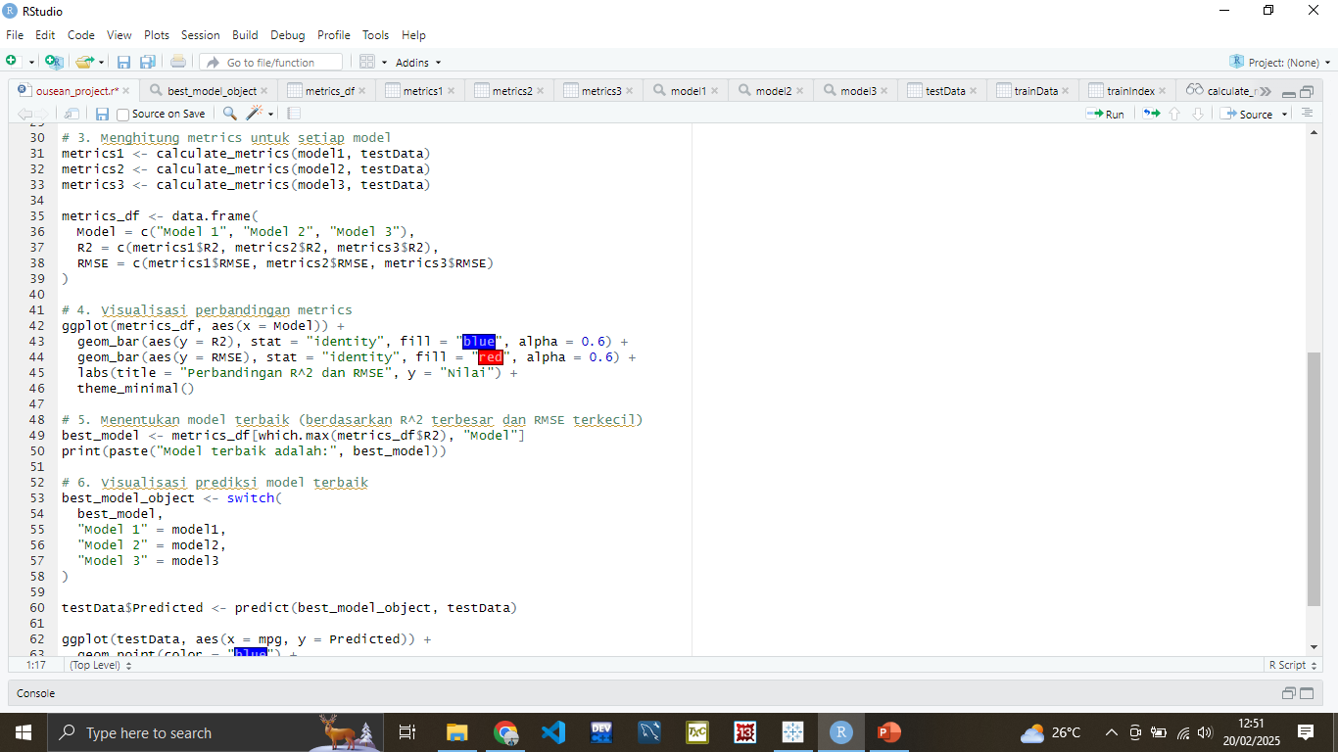
VISUALIZATION METRICS
INPUT
METRICS 1
METRICS 2
METRICS 3

Slide 13
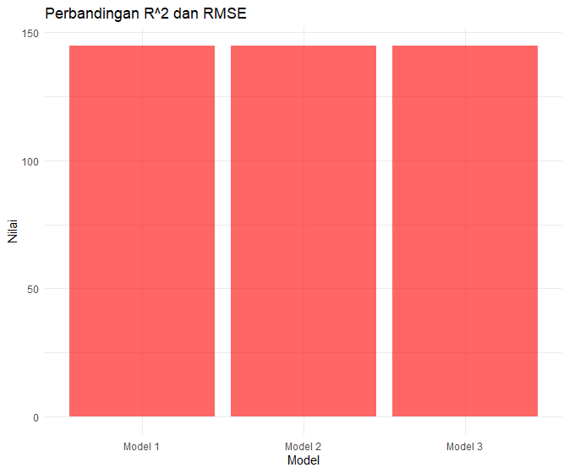
VISUALIZATION METRICS
OUTPUT
METRICS 1
METRICS 2
METRICS 3

Slide 14
BEST MODELLING
INPUT
METRICS 1
METRICS 2
METRICS 3

Slide 15
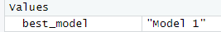
BEST MODELLING
OUTPUT
METRICS 1
METRICS 2
METRICS 3

Slide 16
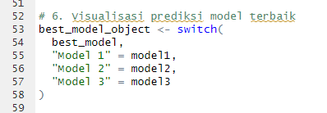
PREDICTION MODEL
INPUT
METRICS 1
METRICS 2
METRICS 3

Slide 17

PREDICTION MODEL
OUTPUT
METRICS 1
METRICS 2
METRICS 3

Slide 18



THANK YOU
More Information : Github Repository

